Slide 1


Day – 1 Jupyter Notebook Installation and setup
Anaconda has many other tools including jupyter so installing it.

Slide 2

Step 1: Search for anaconda distribution in Google

Slide 3

Step 2 Open the below site shown

Slide 4




Step – 3 Click on the download option below

Slide 5
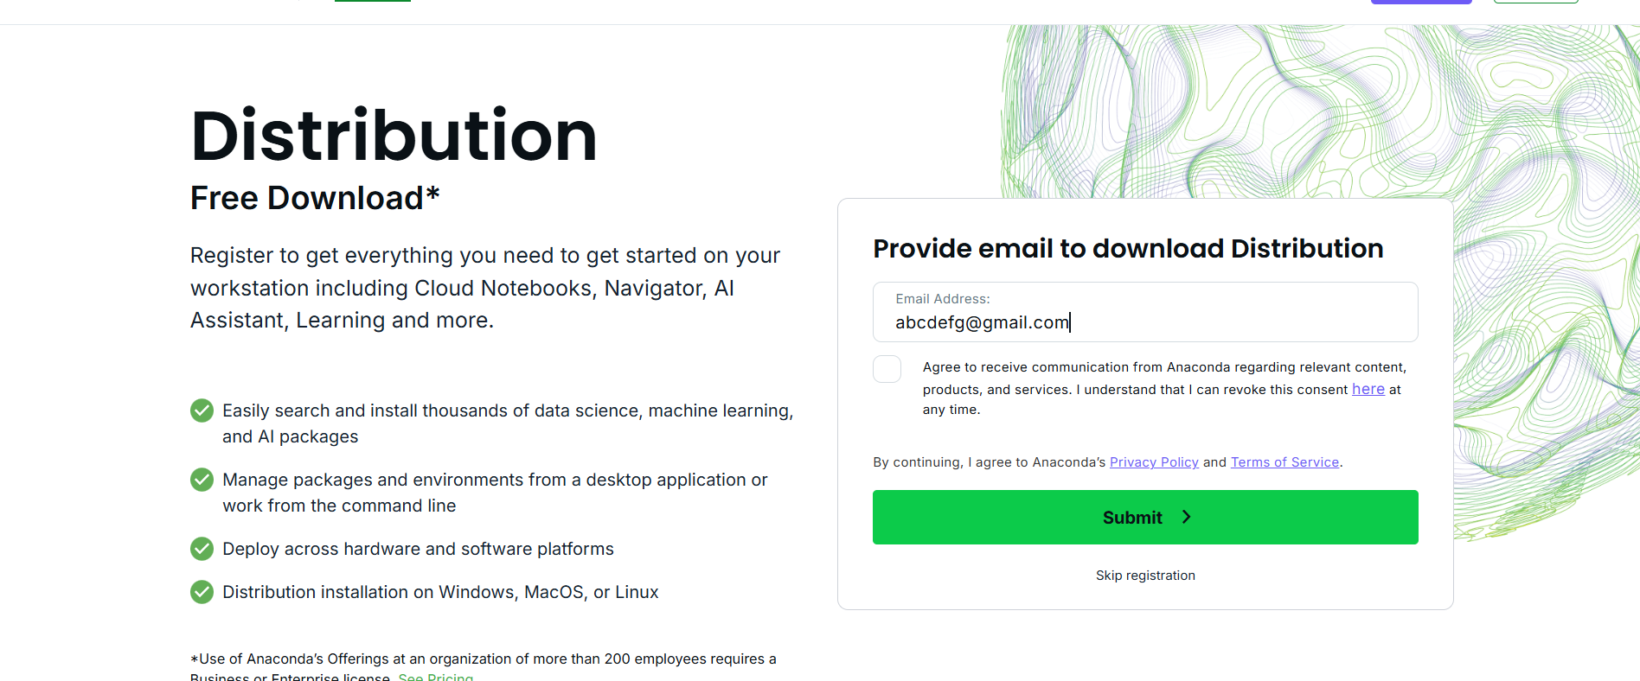
Step 4: It opens this page where you need to give the email id and submit

Slide 6
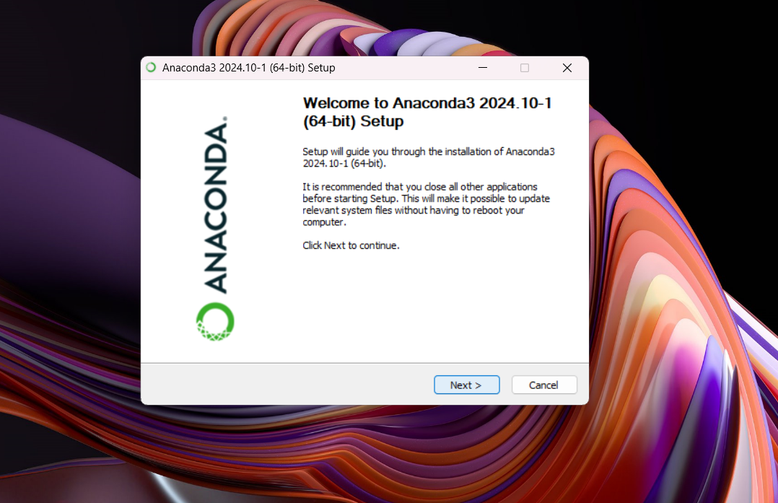
Step 5: After downloading click the downloaded .exe file then this prompt opens

Slide 7
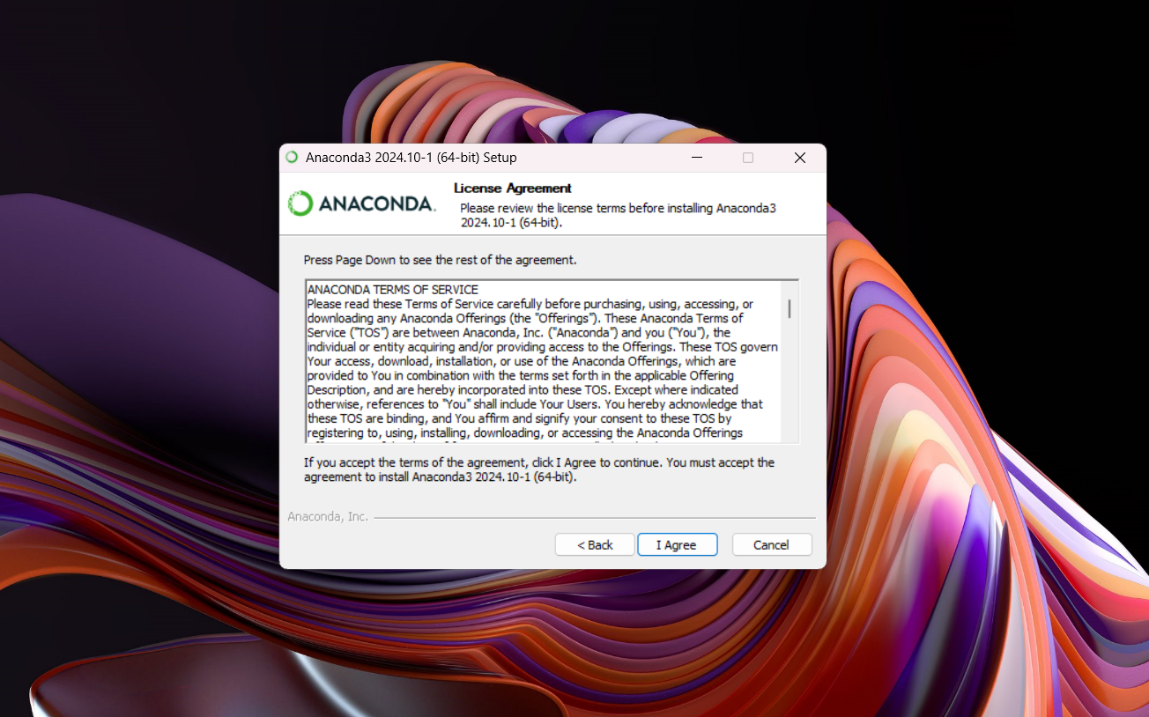
Step 6: Agree the T&C in this page and move ahead

Slide 8
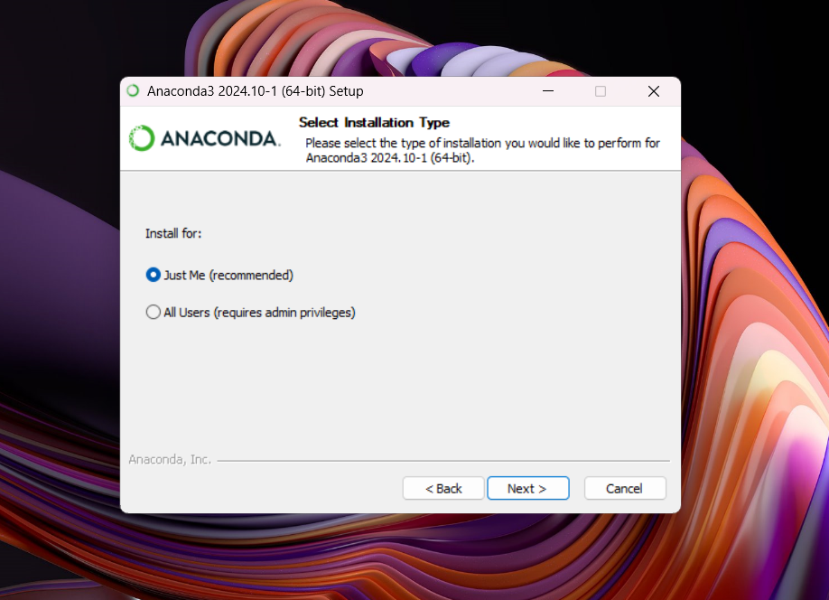
Step 7: select just me radio button and go next

Slide 9
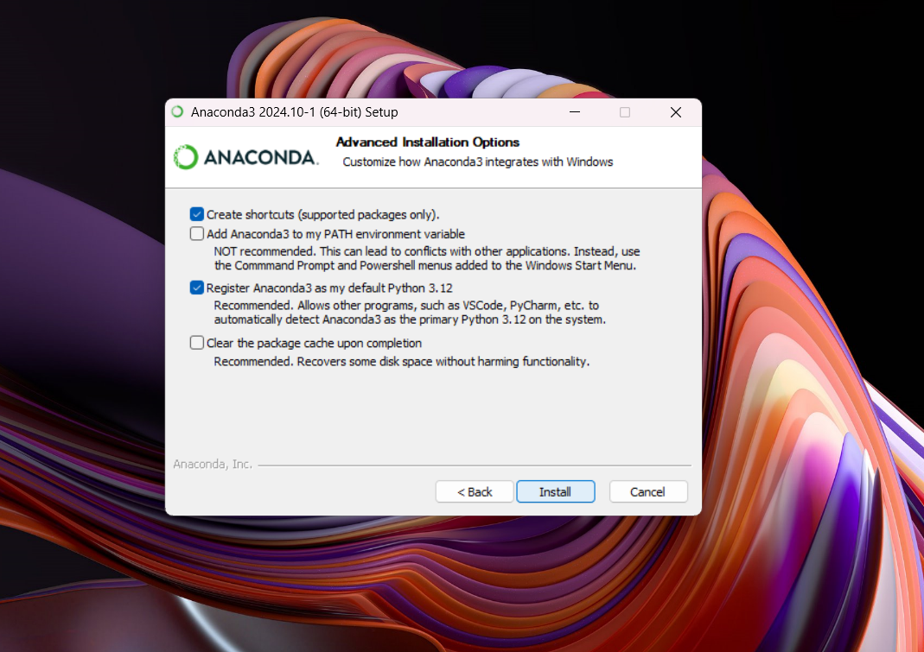
Step 8: Without changing any default checkboxes just click install

Slide 10
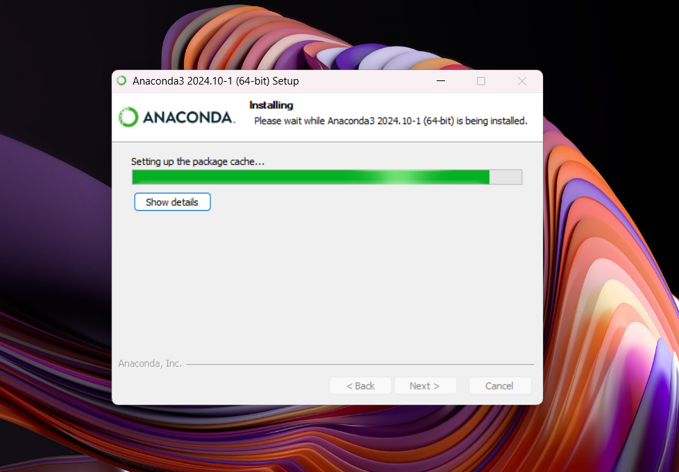
Let the installation complete

Slide 11
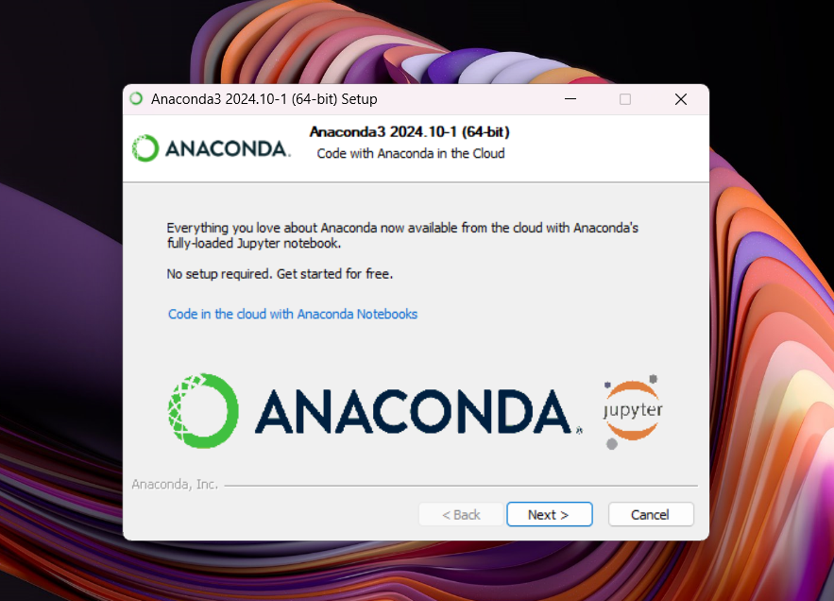
Step 9: As everything came to end click on next

Slide 12
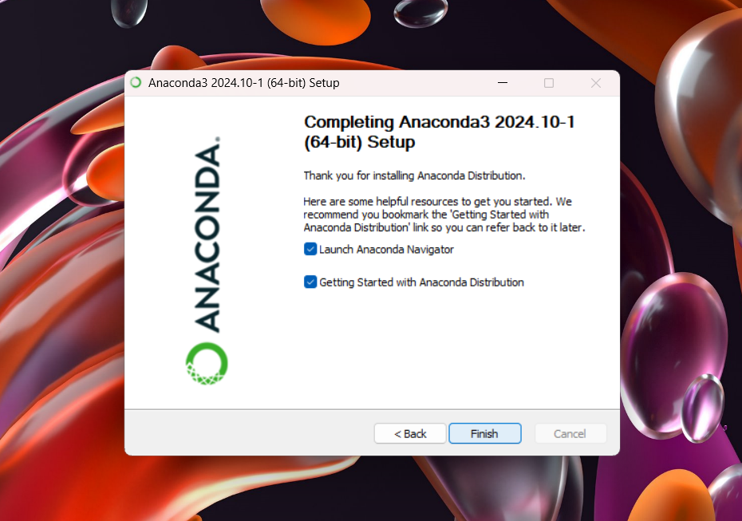
Step 10: Entire installation is done

Slide 13
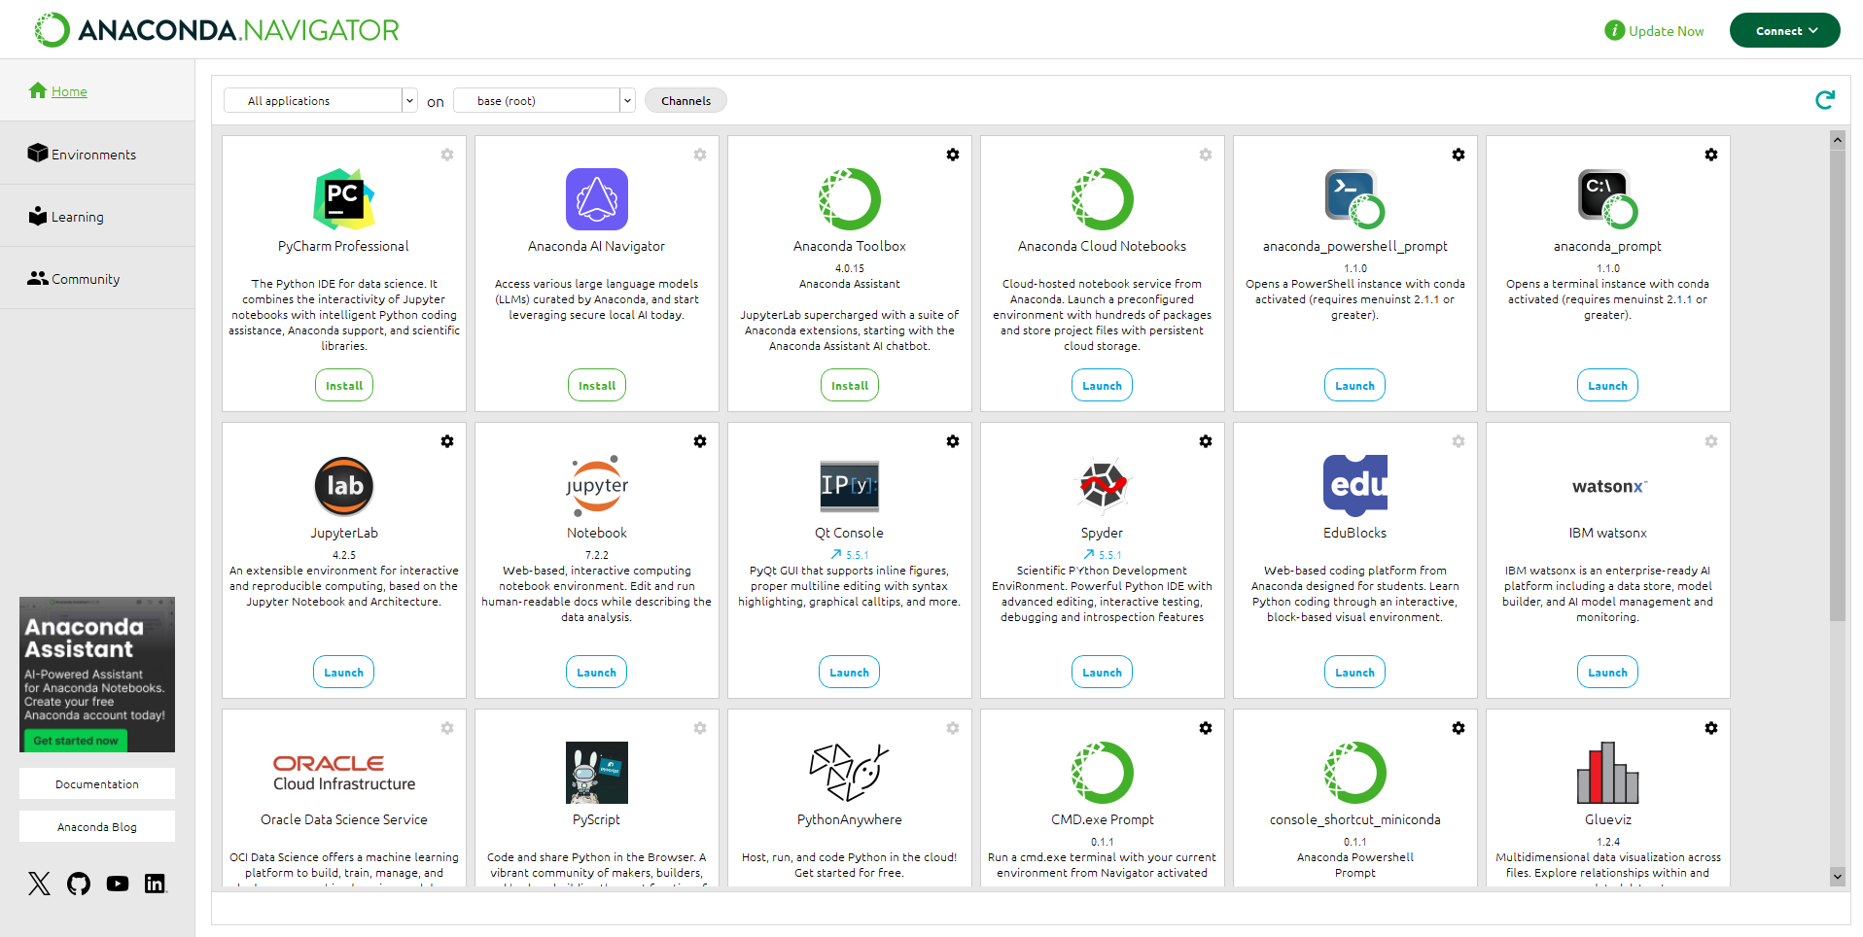
Now you can open Anaconda application where jupyter notebook and many other platforms are available to launch and utilize

